Slide 1
Module-6 Introduction to cryptography
By Dr. Sanjeev Kumar Mandal

Slide 2

Why cryptography?
Course Content
symmetric & asymmetric encryption,
cipher
AES
DES
RSA,
message authentication
hash function,
introduction to digital signature,
block cipher and stream cipher

Slide 3
Definitions
Computer Security - generic name for the collection of tools designed to protect data and to thwart hackers
Network Security - measures to protect data during their transmission
Internet Security - measures to protect data during their transmission over a collection of interconnected networks

Slide 4

Aim
our focus is on Internet Security
which consists of measures to deter, prevent, detect, and correct security violations that involve the transmission & storage of information

Slide 5
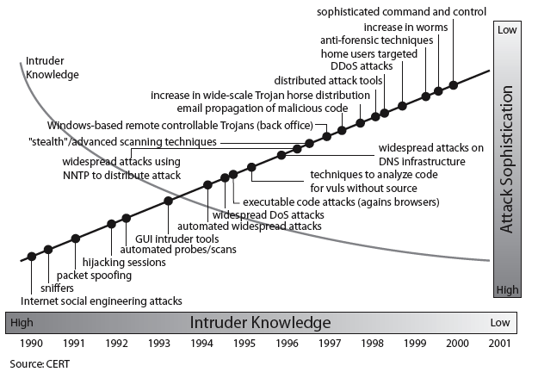
Security Trends

Slide 6
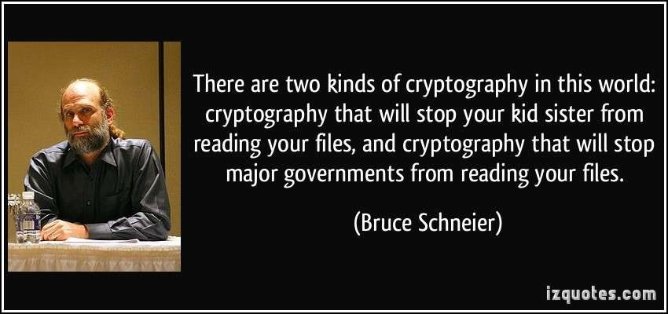

Slide 7
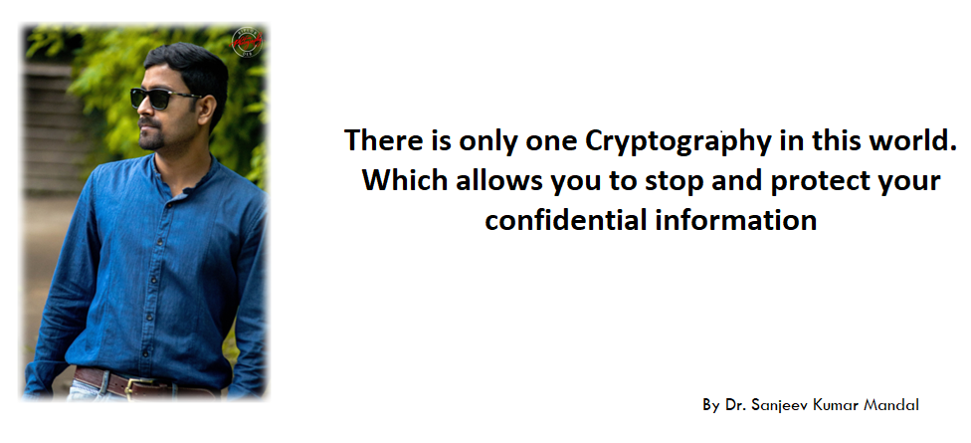

Slide 8
Cryptography is everywhere
Secure communication:
–web traffic: HTTPS
–wireless traffic: 802.11i WPA2 (and WEP), GSM, Bluetooth
Encrypting files on disk: EFS, TrueCrypt
Content protection (e.g. DVD, Blu-ray): CSS, AACS
User authentication
… and much much more

Slide 9
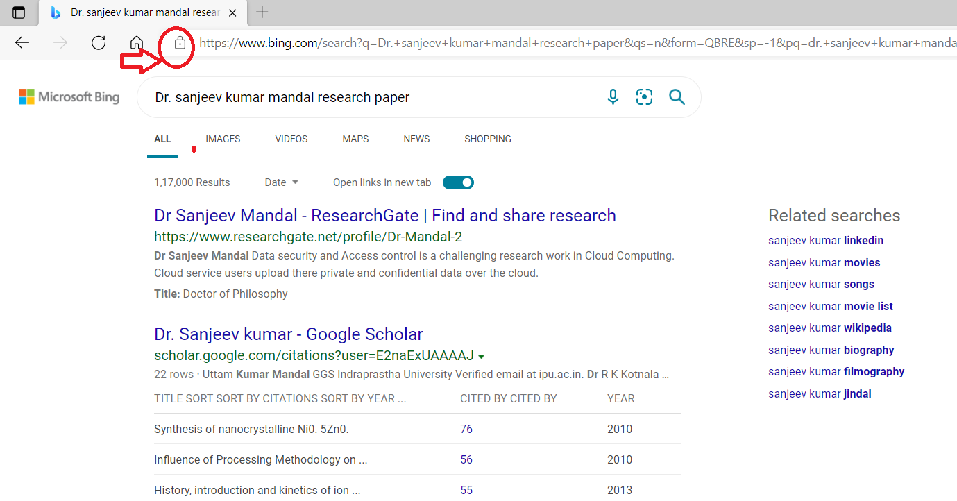
What is https?

Slide 10
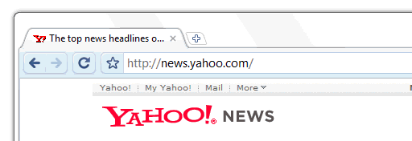
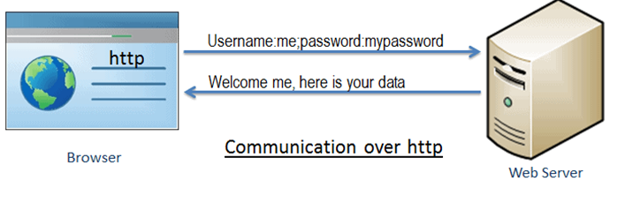
HTTP

Slide 11
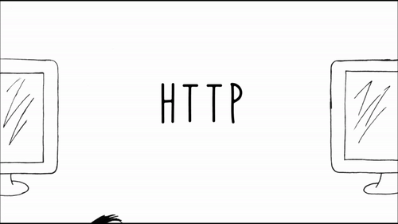
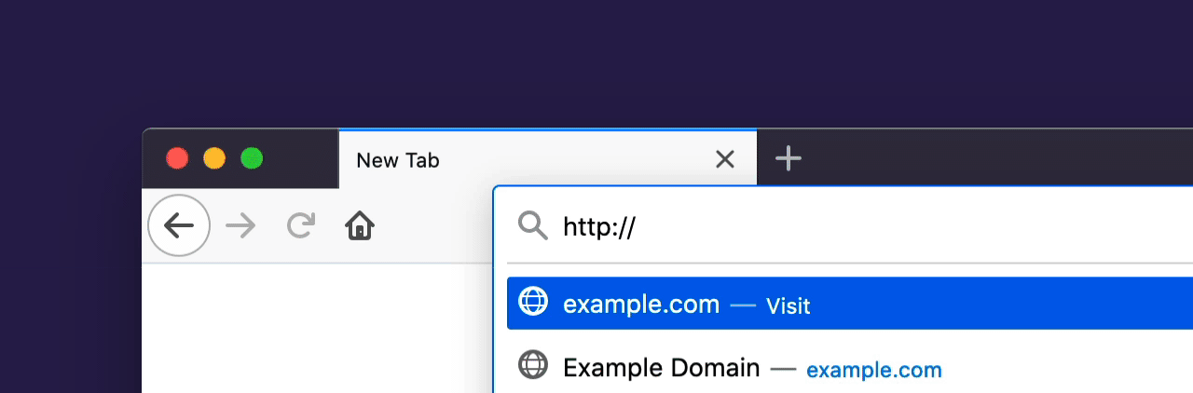
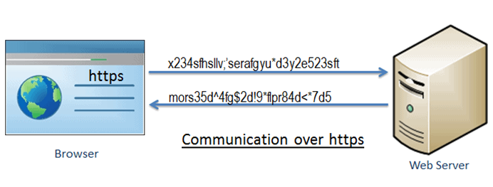
HTTPS

Slide 12
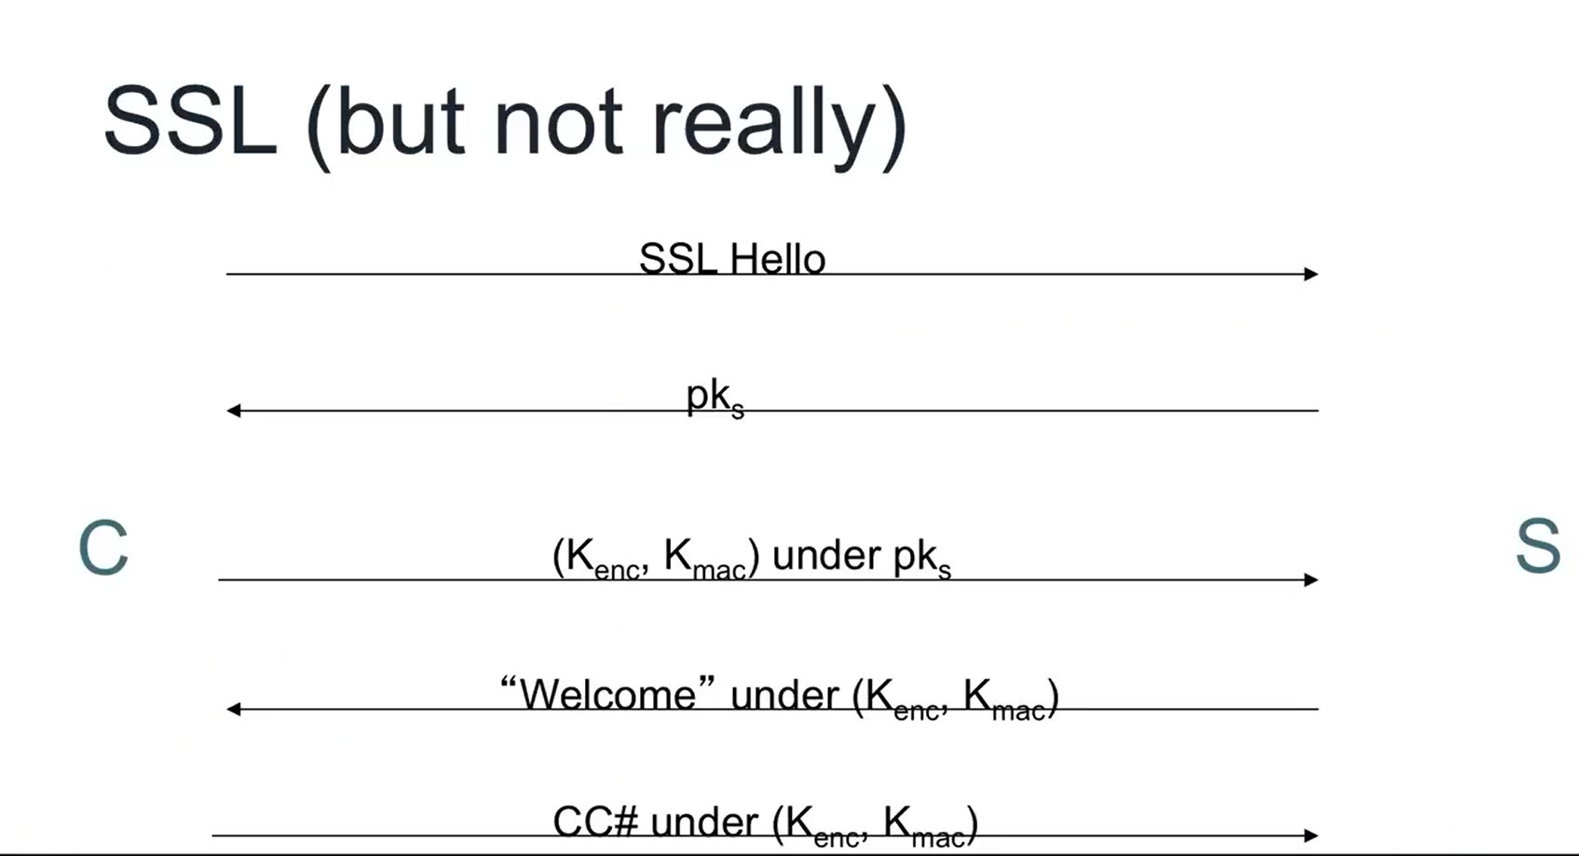
SSL

Slide 13

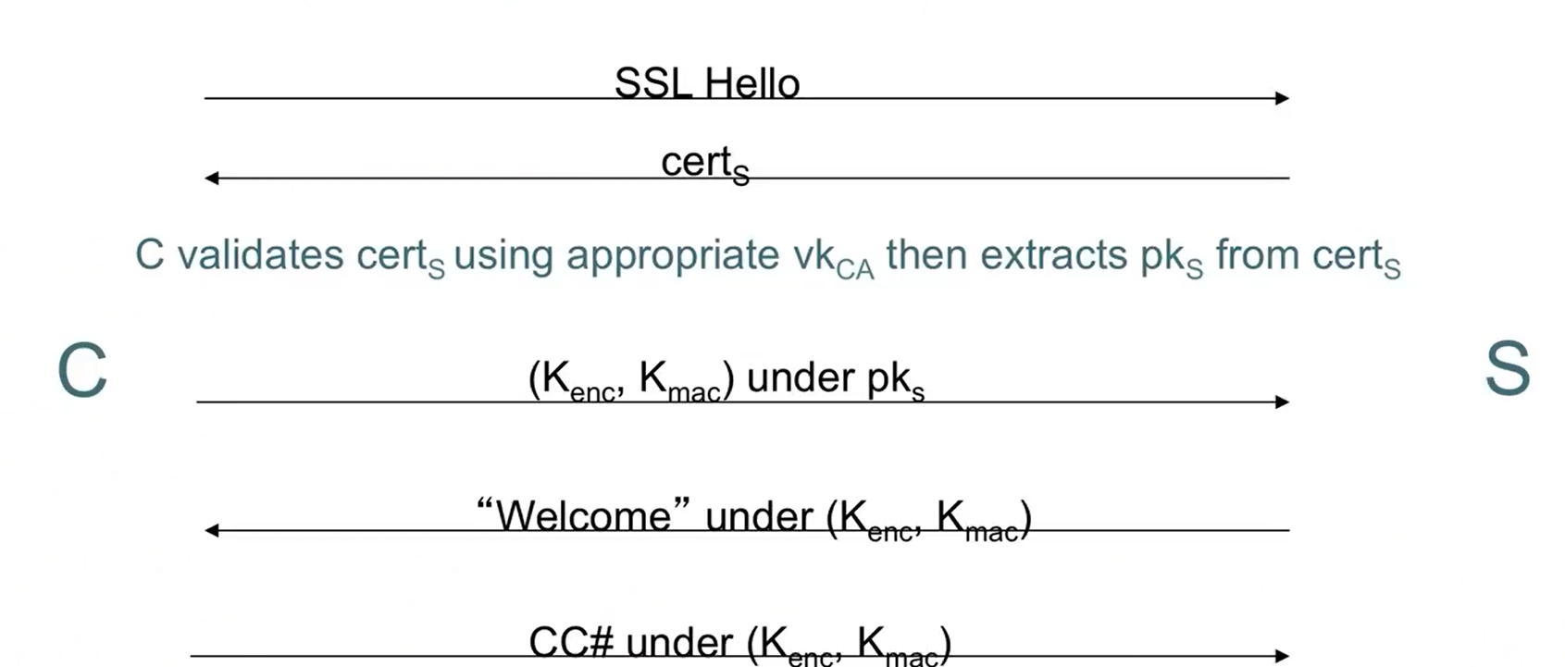
Cont..

Slide 14
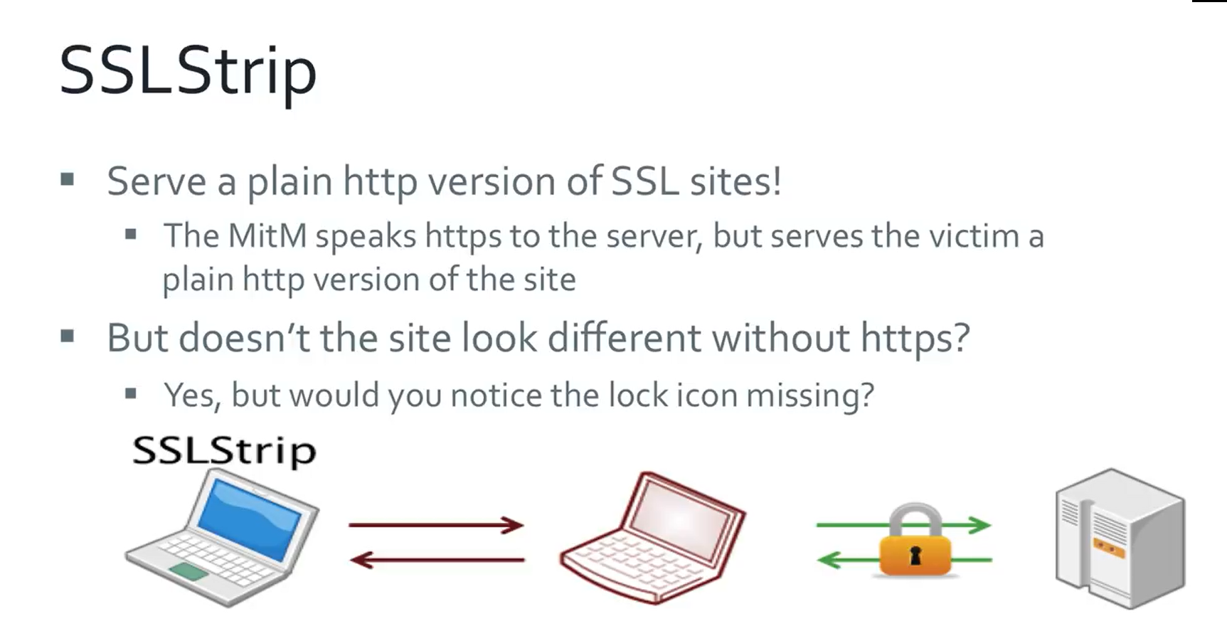

Slide 15
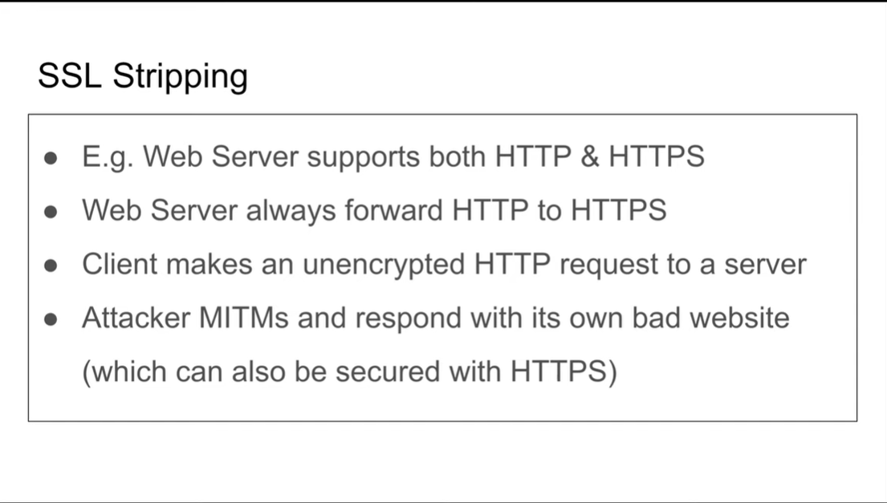

Slide 16
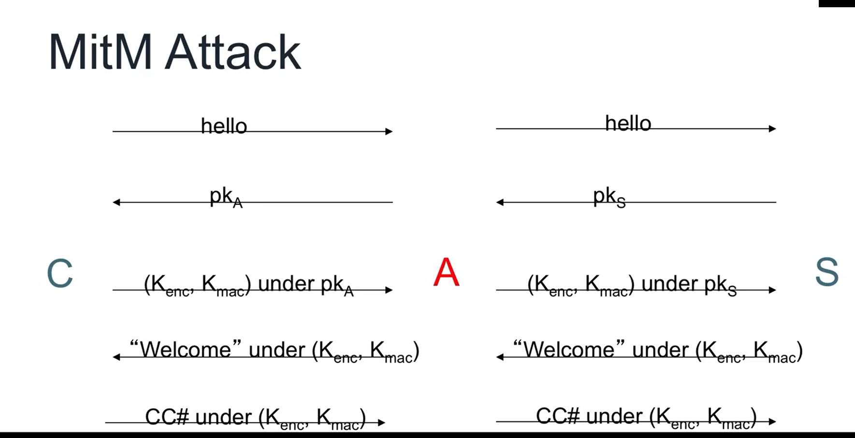

Slide 17
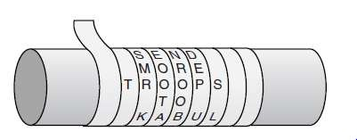
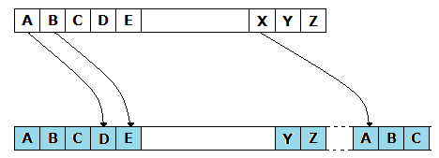
History of Cryptography
◆ The first known evidence of the use of cryptography (in some form) was found in an inscription carved around 1900 BC, in the main chamber of the tomb of the nobleman Khnumhotep II, in Egypt.
◆ Around 400 B.C., the Spartans used a system of encrypting information by writing a message on a sheet of papyrus.
◆ Around 100 B.C., Julius Caesar was known to use a form
of encryption to convey secret messages to his army generals posted in the war front.

Slide 18
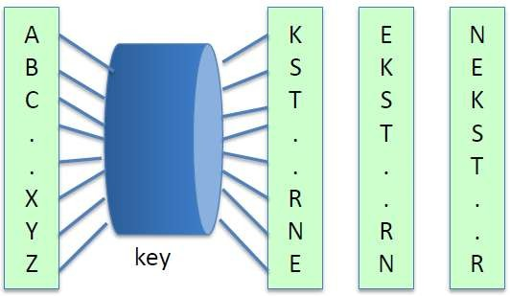
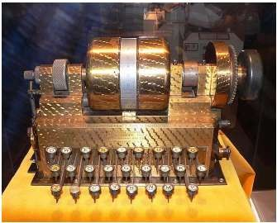
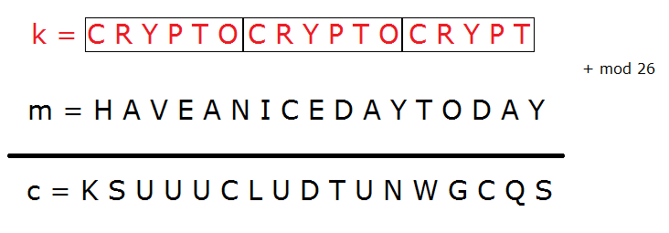
◆ During the 16th century, Vigenere designed a cipher that was supposedly the first cipher that used an encryption key.
◆ At the start of the 19th century when everything became electric, Hebern designed an electro-mechanical contraption which was called the Hebern rotor machine.

Slide 19
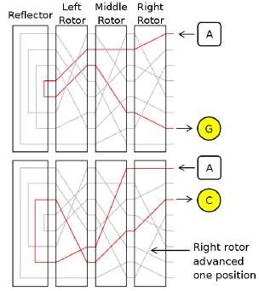
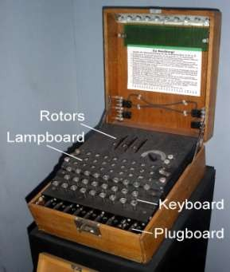
◆ The Engima machine was invented by German engineer Arthur Scherbius at the end of World War I, and was heavily used by the German forces during the Second World War.

Slide 20
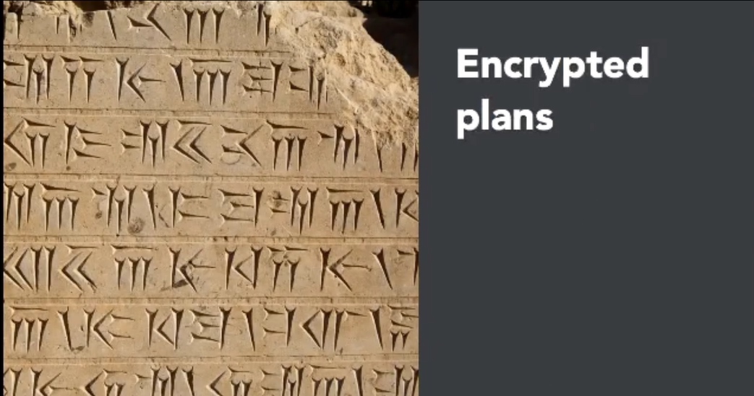
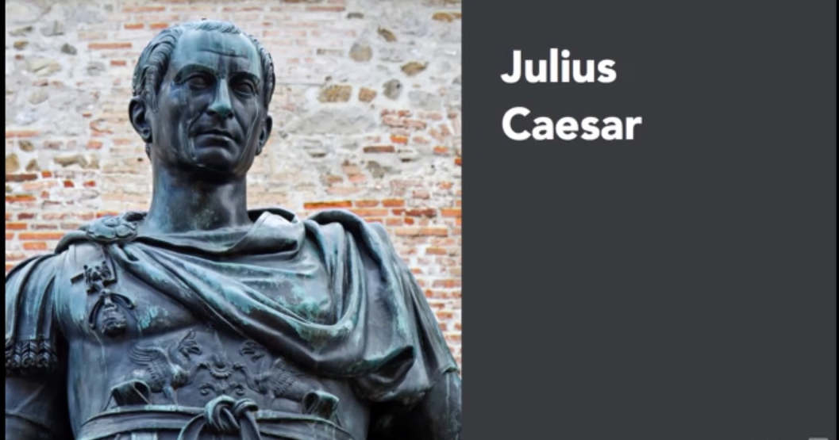
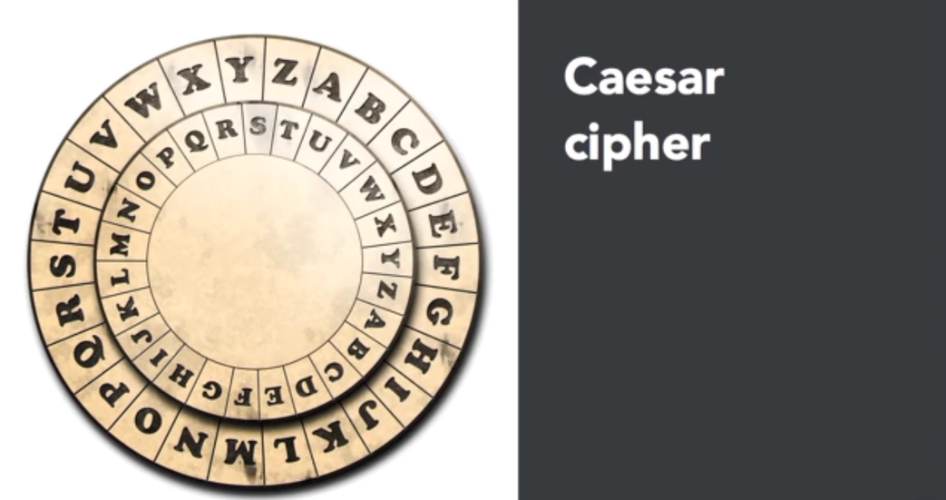

Slide 21
Some Basic Terminology
Plaintext - original message
Ciphertext – a coded message
Cipher - algorithm for transforming plaintext to ciphertext
key - info used in cipher known only to sender/receiver
Encipher (encrypt) - converting plaintext to ciphertext
Decipher (decrypt) - recovering ciphertext into plaintext
Cryptography – the study of encryption principles/methods
Cryptanalysis (codebreaking) – the study of principles/ methods of deciphering ciphertext without knowing key
Cryptology - field of both cryptography and cryptanalysis

Slide 22

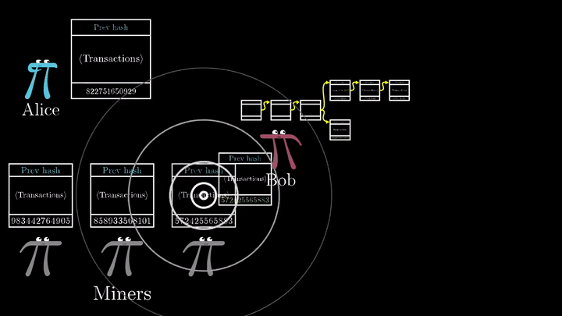
Cryptanalysis
objective to recover key not just message
general approaches:
cryptanalytic attack
brute-force attack

Slide 23
Cryptanalytic Attacks
ciphertext only
only know algorithm & ciphertext, is statistical, know or can identify plaintext
known plaintext
know/suspect plaintext & ciphertext
chosen plaintext
select plaintext and obtain ciphertext
chosen ciphertext
select ciphertext and obtain plaintext
chosen text
select plaintext or ciphertext to en/decrypt

Slide 24
Brute Force Search
always possible to simply try every key
most basic attack, proportional to key size
assume either know / recognise plaintext
always possible to simply try every key
most basic attack, proportional to key size
assume either know / recognise plaintext
Key Size (bits) | Number of Alternative Keys | Time required at 1 decryption/µs | Time required at 10⁶ decryptions/µs
32 | 2³² = 4.3 × 10⁹ | 2³¹ µs = 35.8 minutes | 2.15 milliseconds
56 | 2⁵⁶ = 7.2 × 10¹⁶ | 2⁵⁵ µs = 1142 years | 10.01 hours
128 | 2¹²⁸ = 3.4 × 10³⁸ | 2¹²⁷ µs = 5.4 × 10²⁴ years | 5.4 × 10¹⁸ years
168 | 2¹⁶⁸ = 3.7 × 10⁵⁰ | 2¹⁶⁷ µs = 5.9 × 10³⁶ years | 5.9 × 10³⁰ years
26 characters (permutation) | 26! = 4 × 10²⁶ | 2 × 10²⁶ µs = 6.4 × 10¹² years | 6.4 × 10⁶ years

Slide 25

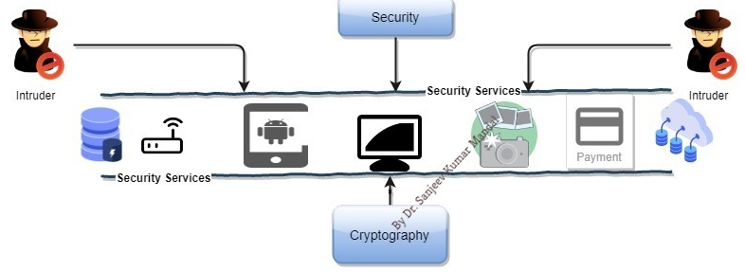
Why Encryption?
Encryption is what keeps your personal data secure when you're shopping or banking online. It scrambles data like your credit card details and home address to ensure hackers can't misuse this information.

Slide 26
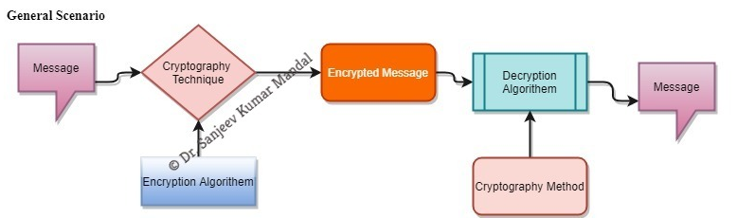
What is Cryptography?
The art and science of concealing the messages to introduce secrecy in information security is recognized as cryptography.
Plaintext
Encryption Algorithm
Ciphertext
Decryption Algorithm
Plaintext

Slide 27
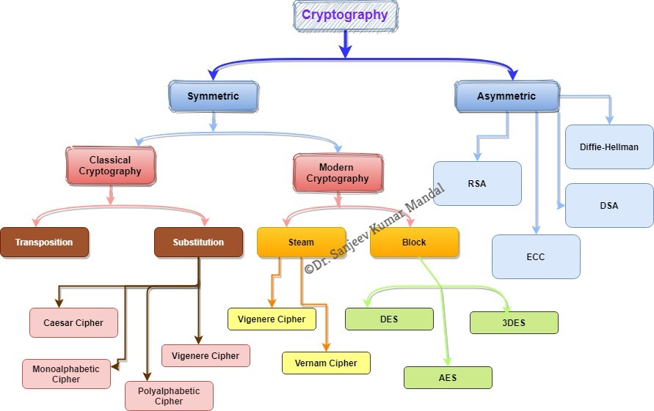
Cryptography is divided into 3 into depended dimensions
Operation is used to transform plaintext into ciphertext(Substitution & transposition)
The Number of Key (Symmetric/Asymmetric)
The way in which the plaintext is processed (Block/Steam)

Slide 28
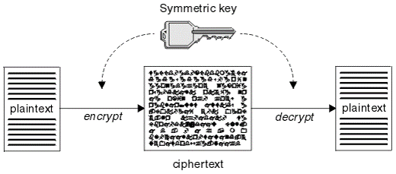
Symmetric Encryption
A symmetric encryption is any technique where the same key is used to both encrypt and decrypt the data.
Types
Classical Cryptographic
Modern Cryptography

Slide 29
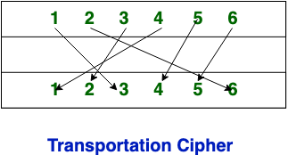
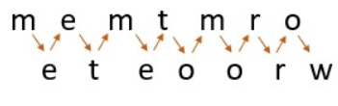
Classical Cryptographic
Transposition cipher technique
Substitution cipher technique
Transposition Cipher Technique: Transposition Cipher Technique rearranges the position of the plain text’s characters. The position of the character is changed but character’s identity is not changed.
Transposition Techniques
Rail Fence Transposition
Columnar Transposition

Slide 30
Substitution Cipher
Substitution Cipher Technique: In Substitution Cipher Technique plain text characters are replaced with other characters, numbers and symbols as well as in substitution Cipher Technique, character’s identity is changed while its position remains unchanged.
Caesar Cipher
Monoalphabetic Ciphers
Playfair Cipher
One-Time Pad

Slide 31
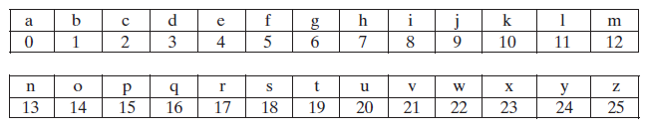
Substitution Cipher Technique
Caesar Cipher: The Caesar cipher involves replacing each letter of the alphabet with the letter standing three places further down the alphabet.
For example: Shift << 3
plain: MEET ME AFTER THE TOGA PARTY
cipher:PHHW PH DIWHU WKH WRJD SDUWB
Algorithm can be expressed as follows. For each plaintext letter p, Key K and Ciphertext letter C.
Encryption :- C = E(k, p) = (p + k) mod 26
C = E(3, m) = (12 + 3) mod 26 = 15 ------> Letter p
Decryption :- p = D(k, C) = (C - k) mod 26

Slide 32
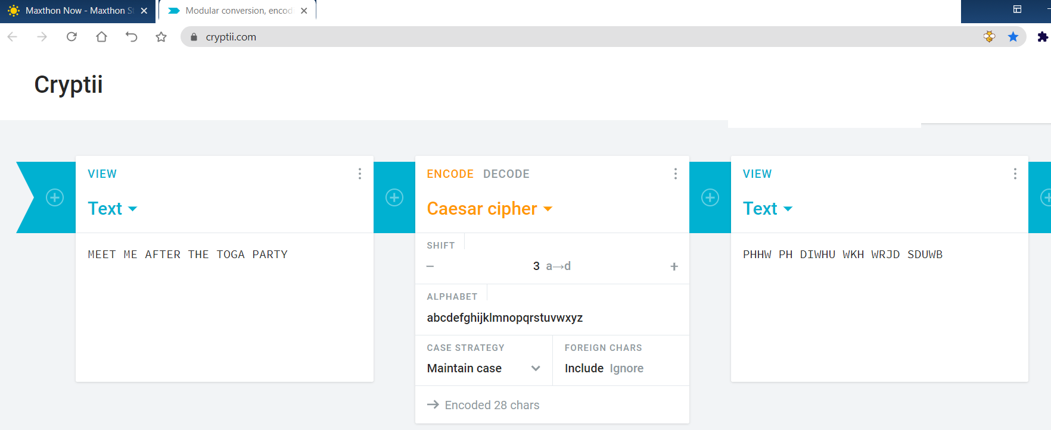
Example:

Slide 33
Monoalphabetic Ciphers
With only 25 possible keys, the Caesar cipher is far from secure. A dramatic increase in the key space can be achieved by allowing an arbitrary substitution.
Monoalphabetic Ciphers uses a permutation method of a finite set of elements is an ordered sequence of all the elements of , with each element appearing exactly once. For example, if S = {a, b, c} there are six permutations of :
abc, acb, bac, bca, cab, cba

Slide 34
Polyalphabetic Ciphers
Another way to improve on the simple monoalphabetic technique is to use different monoalphabetic substitutions as one proceeds through the plaintext message.
The general name for this approach is polyalphabetic substitution cipher.
VIGEN`ERE CIPHER The best known, and one of the simplest, polyalphabetic ciphers is the Vigenère cipher. In this scheme, the set of related monoalphabetic substitution rules consists of the 26 Caesar ciphers with shifts of 0 through 25.

Slide 35
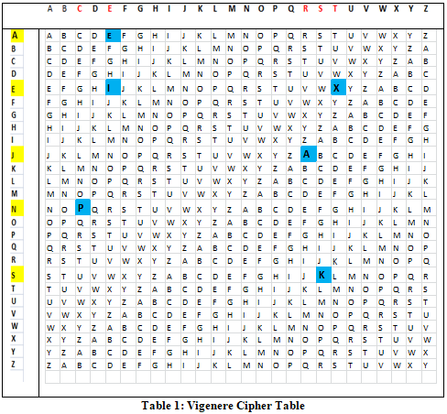
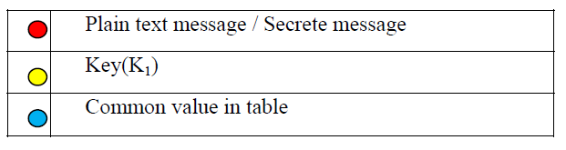
Research Example
Plaintext: S E C R E T
KEY: S A N J E E
From this Vigenere Cipher table, the generated Ciphertext is “KEPAIX”

Slide 36
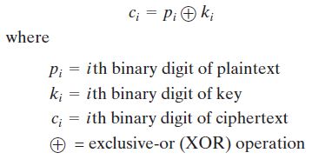
VERNAM CIPHER
The Vernam Cipher is based on the principle that each plaintext character from a message is 'mixed' with one character from a key stream.
Example:
Plain: sanjeev
Binary Value is: 01110011 01100001 01101110 01101010 01100101 01100101 01110110
Key: jain
Binary Value: 01101010 01100001 01101001 01101110
Afetr XOR Encryption
Ciphertext: 00-00-00-01-01-00-00-01-00-00-00-00-00-00-00-00-00-00-00-00-00-00-00-01-01-01-00-00-00-00-00-00-01-00-00-10-01-00-01-01-00-00-00-11-10-01-00-01-00-00-01-01-11-10-01-00-01-00-00-01-00-10

Slide 37
One-Time Pad
if a truly random key as long as the message is used, the cipher will be secure called a One-Time pad is unbreakable since ciphertext bears no statistical relationship to the plaintext
since for any plaintext & any ciphertext there exists a key mapping one to other can only use the key once though problems in generation & safe distribution of key
Notes:
The One-Time Pad is an evolution of the Vernham cipher, which was invented by Gilbert Vernham in 1918, and used a long tape of random letters to encrypt the message. An Army Signal Corp officer, Joseph Mauborgne, proposed an improvement using a random key that was truly as long as the message, with no repetitions, which thus totally obscures the original message. It produces random output that bears no statistical relationship to the plaintext. Because the ciphertext contains no information whatsoever about the plaintext, there is simply no way to break the code, since any plaintext can be mapped to any ciphertext given some key.
The one-time pad offers complete security but, in practice, has two fundamental difficulties:
There is the practical problem of making large quantities of random keys.
2. And the problem of key distribution and protection, where for every message to be sent, a key of equal length is needed by both sender and receiver.
Because of these difficulties, the one-time pad is of limited utility, and is useful primarily for low-bandwidth channels requiring very high security.

Slide 38
Transposition Ciphers
now consider classical transposition or permutation ciphers
these hide the message by rearranging the letter order
without altering the actual letters used
can recognise these since have the same frequency distribution as the original text
Notes:
All the techniques examined so far involve the substitution of a ciphertext symbol for a plaintext symbol. A very different kind of mapping is achieved by performing some sort of permutation on the plaintext letters. This technique is referred to as a transposition cipher, and form the second basic building block of ciphers. The core idea is to rearrange the order of basic units (letters/bytes/bits) without altering their actual values.

Slide 39
Rail Fence cipher
write message letters out diagonally over a number of rows
then read off cipher row by row
eg. write message out as:
m e m a t r h t g p r y
e t e f e t e o a a t
giving ciphertext
MEMATRHTGPRYETEFETEOAAT
Notes:
The simplest such cipher is the rail fence technique, in which the plaintext is written down as a sequence of diagonals and then read off as a sequence of rows.
The example message is: "meet me after the toga party" with a rail fence of depth 2.
This sort of thing would be trivial to cryptanalyze.

Slide 40
Row Transposition Ciphers
a more complex transposition
write letters of message out in rows over a specified number of columns
then reorder the columns according to some key before reading off the rows
Key: 3 4 2 1 5 6 7
Plaintext: a t t a c k p
o s t p o n e
d u n t i l t
w o a m x y z
Ciphertext: TTNAAPTMTSUOAODWCOIXKNLYPETZ
Notes:
A more complex transposition cipher is to write the message in a rectangle, row by row, and read the message off shuffling the order of the columns in each row.
A pure transposition cipher is easily recognized because it has the same letter frequencies as the original plaintext. For the type of columnar transposition just shown, cryptanalysis is fairly straightforward and involves laying out the ciphertext in a matrix and playing around with column positions. Digram and trigram frequency tables can be useful.

Slide 41
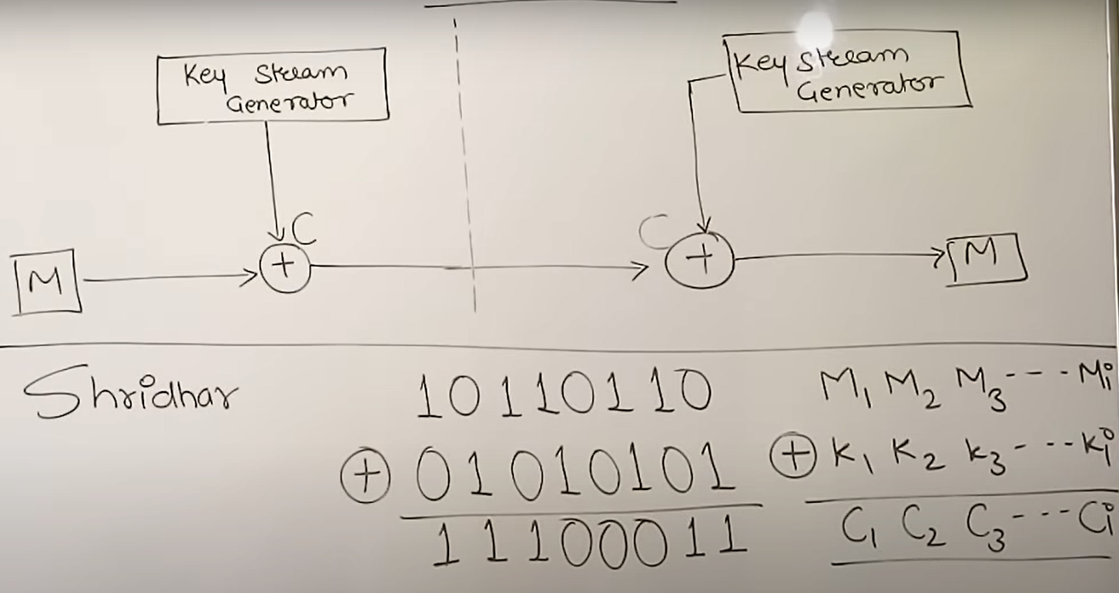
Modern Cryptography
stream cipher : A stream cipher is one that encrypts a digital data stream one bit or one byte at a time.
Examples of classical stream ciphers are the autokeyed Vigenère cipher and the Vernam cipher.

Slide 42
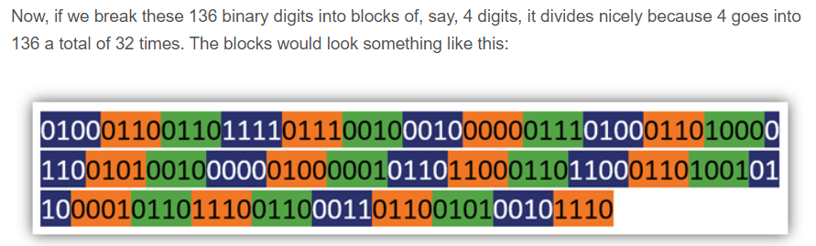
A block cipher is one in which a block of plaintext is treated as a whole and used to produce a ciphertext block of equal length. Typically, a block size of 64 or 128 bits is used.
Block Cipher
Example: AES, DES, 3DES, etc
DES: The Data Encryption Standard is a symmetric-key algorithm for the encryption of digital data. Although its short key length of 56 bits makes it too insecure for applications, it has been highly influential in the advancement of cryptography.
Triple DES: In cryptography, Triple DES, officially the Triple Data Encryption Algorithm, is a symmetric-key block cipher, which applies the DES cipher algorithm three times to each data block.

Slide 43
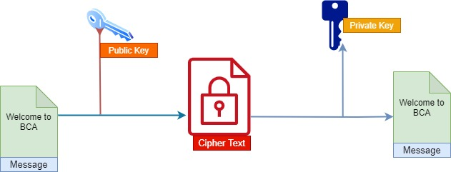
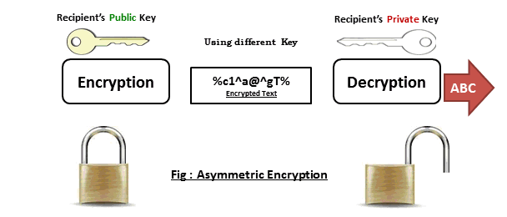
Asymmetric Encryption
AES
RSA
Diffie Hellman
DSA
ECC

Slide 44
AES
Design
AES is 128bit Symmetric Block Cipher with key size of 128, 192, 256 bits.
AES uses some amount of substitution and permutation.
AES don’t work one bit input and one bite output at one time like Other cipher arrange long line of 0,1 bite
In AES arrange everything in 4 * 4 Grid for 128 bite
bo | b4 | b8 | b12
b1 | b5 | b9 | b13
b2 | b6 | b10 | b14
b3 | b7 | b11 | b15

Slide 45
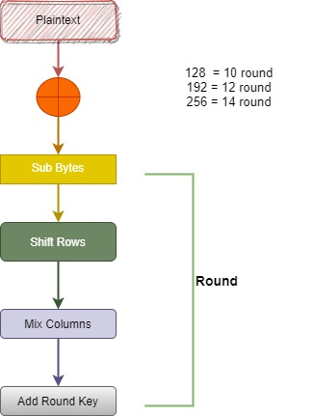

Slide 46
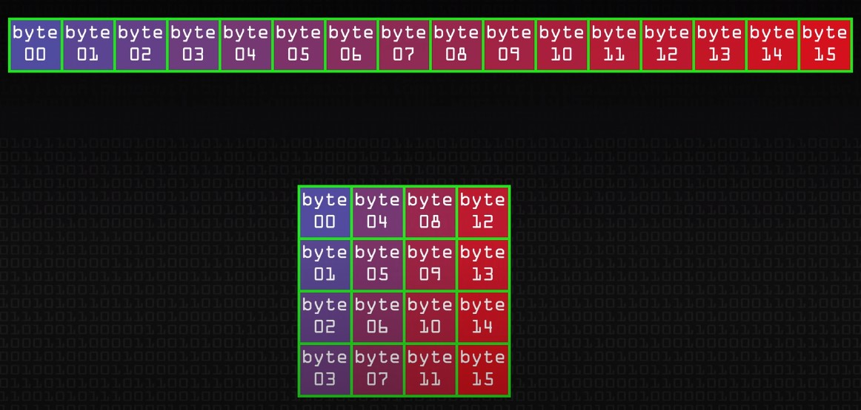
4 * 4 Grid
Remember everything happens in AES its happening in 4 * 4 Grid only

Slide 47
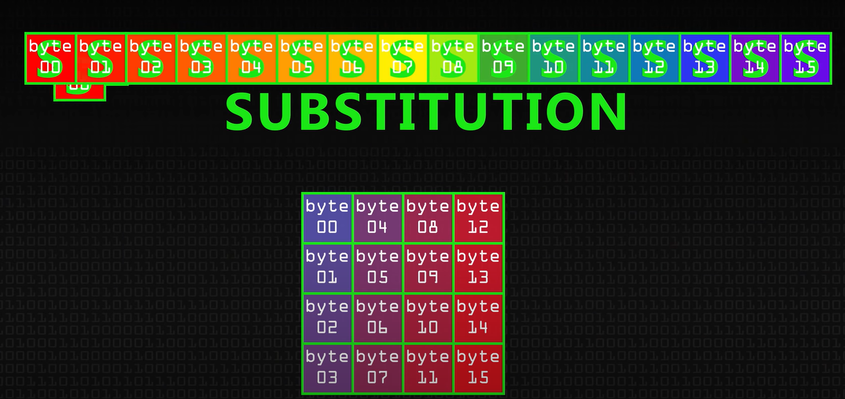
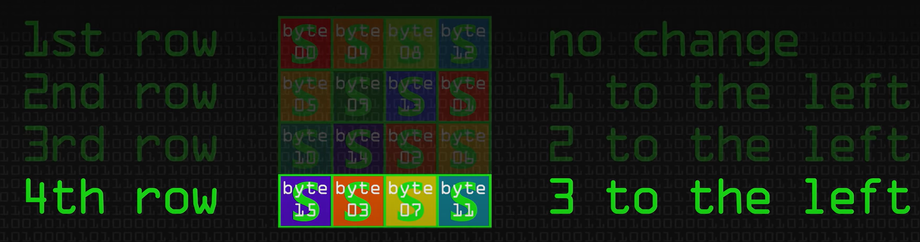
Shift Rows

Slide 48
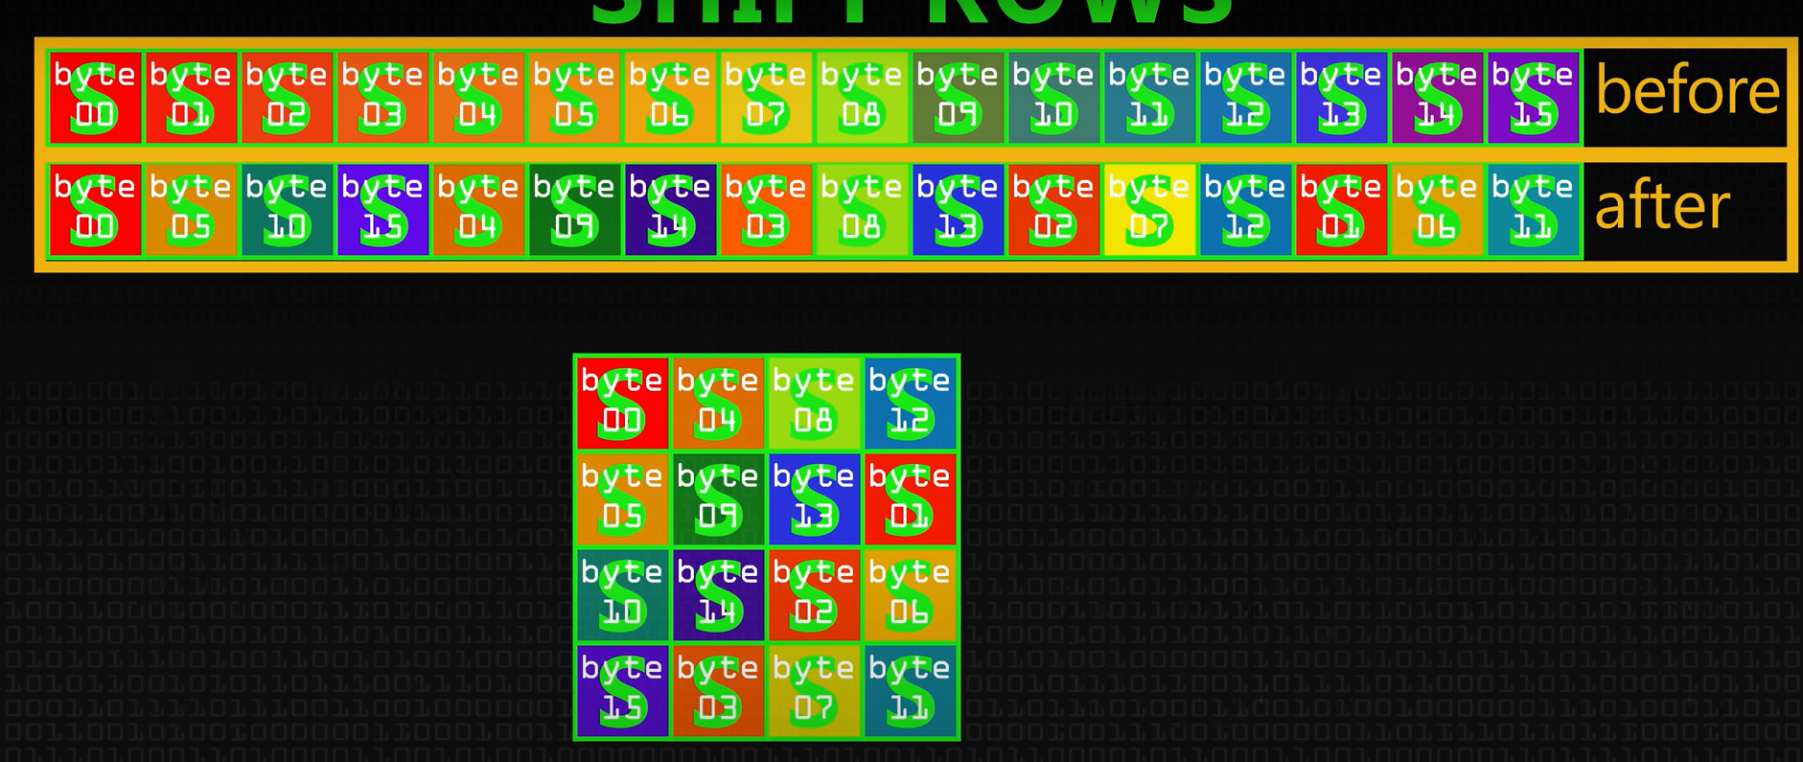
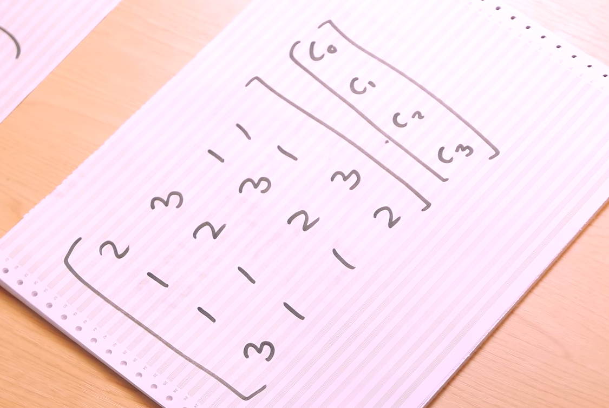
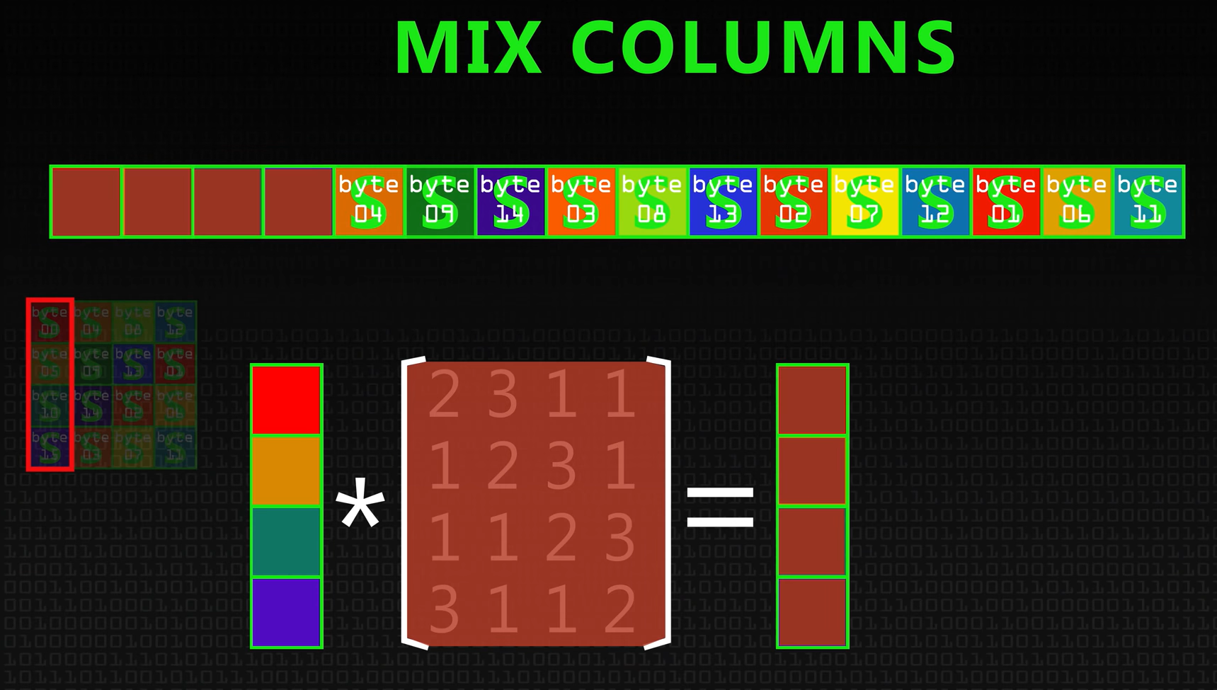
Shift Rows
Mix Columns

Slide 49
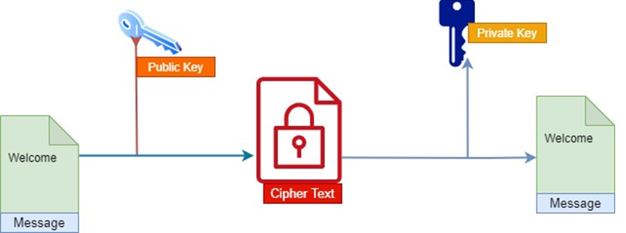
Asymmetric Encryption
Asymmetric Encryption uses two distinct, yet related keys.
One key, the Public Key, is used for encryption and the other, the Private Key, is for decryption.
Private Key is intended to be private so that only the authenticated recipient can decrypt the message.
Each person (or their computer) must generate a pair of keys that identifies them: a private key and a public key.

Slide 50
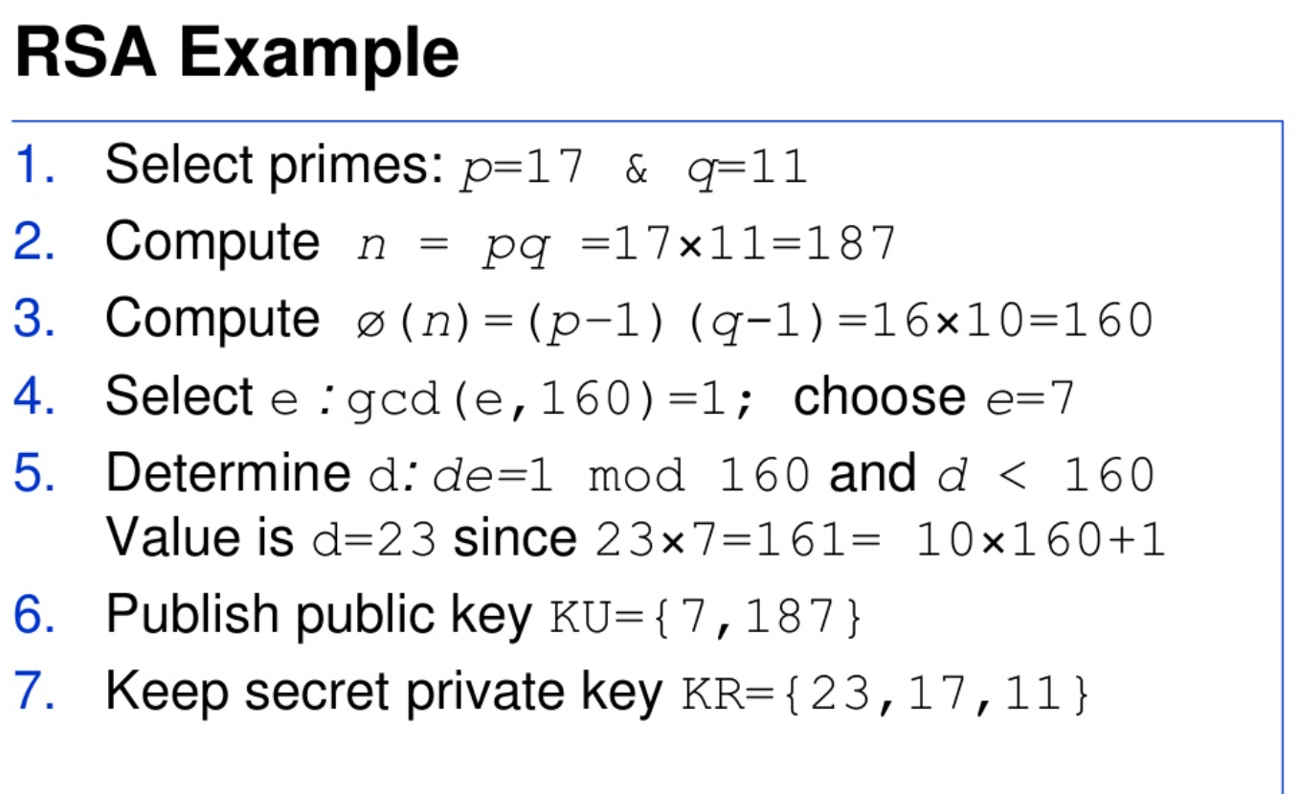
RSA

Slide 51
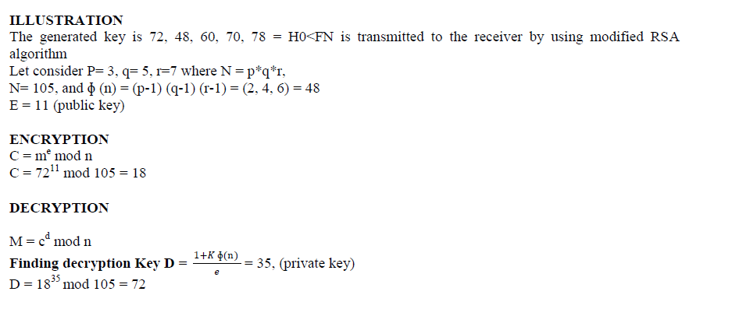
Modified RSA Example By Dr. Sanjeev Kumar Mandal

Slide 52

Diffie Hellman

Slide 53

Diffie Hellman Example

Slide 54


